Slide 1
Welcome to Parent Night!
Miss Kalaka 4th Grade Math & Science
Mrs. Rossi 4th Grade ELA & Social Studies
Mrs. Cardoso

Slide 2
Parent Night
The purpose of tonight’s meeting is to get acquainted and give you an overview of the goals and expectations of fourth grade.
Our Goals for the Class:
1. For children to grow socially, emotionally, and academically.
2. For children to take responsibility of their own learning and build a strong work ethic.
3. For children to strive to be the best students they can be.
4. For children to feel positive and confident.
5. For children to develop time management and problem solving strategies.

Slide 3
Respect yourself, the teacher & others
Put forth your best effort at all times
Be prepared for class each day
Follow directions when given
Pay attention, participate and ask questions
Preserve a positive learning environment
Take responsibility for your actions

Slide 4
PBIS-Positive behavior Interventions & Supports

Slide 5
Rewards and consequences
GOAL: Friday Fun Day!
NO Warnings = 5 individual Tiger Tokens AND can take part in fun Friday
Warnings: 3 verbal warnings and then if behaviors continue the warnings will be marked down
5 warnings for the week = NO Friday Fun Day

Slide 6
Daily planners/Communication
Planner/take-home folder: The planner will be in the green binder. Please review and sign the planner each night. Please check the take-home folder each night for important handouts, letters and homework. Communication:
We will utilize the Remind app, student daily planners, teacher websites and email. Please free to email us anytime or jot a note in the planner!

Slide 7
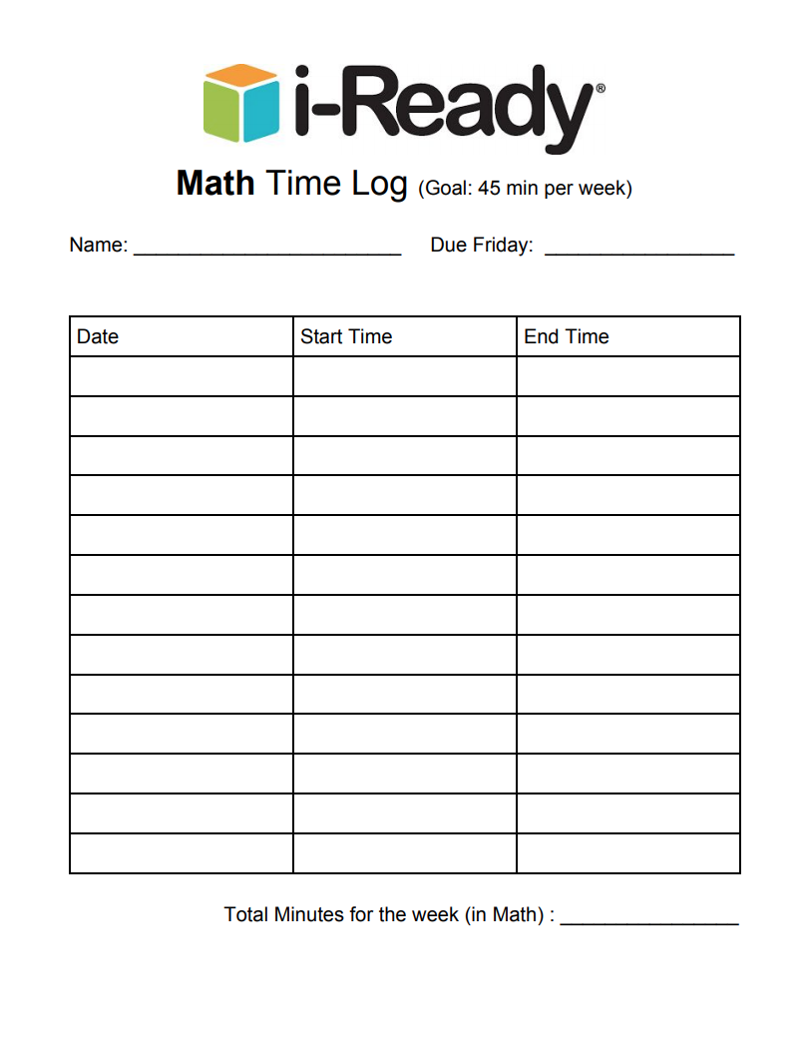
Math Homework
45 minutes of i-Ready weekly
The i-Ready log will be given on Monday and needs to be handed in Friday
Daily homework: a math worksheet with 10 review problems

Slide 8
Math Workshop
80 minute block
Math interactive notebook, Math and Focus, NYS Engage NY Modules
10-15 minute mini lesson
60 minute center rotations
4 groups- rotate every 15 minutes

Slide 10
Math Curriculum
Place Value
Adding and Subtracting Multi-digit numbers
Multiplication
Division
Factors & Multiples
Fractions
Data
Decimals
Measurement
Geometry

Slide 11
Science Curriculum
Fourth Grade -Organization in the Natural World
Unit 1: Organizing Ourselves for Doing Science
Unit 2: Digestion, Nutrients, Food Chains and Food Webs
Unit 3: Simple Machines
Unit 4: Organization of the Earth (constructive and destructive forces, rocks and minerals)

Slide 12
SChedule

Slide 13
Grading Policy
Grading Procedure
All of our grading is based on a 1-4 proficiency scale.
4 indicates the student is exceeding the grade level standards.
3 is meeting the grade level expectations.
2 is working towards grade level expectations.
1 is performing below grade level.

Slide 14
Snack
A working snack will be available to students at 2:00-3:00
Students may bring water bottles to school- it is important to stay hydrated especially in the heat!

Slide 15
In order to increase you child’s academic success:
Make attendance a priority and limit tardiness
Communicate with your child’s teacher(s)
Stay informed through our school’s webpage, teacher webpages, Remind, & Twitter
Ensure your child reads and minimum of 20 minutes and practices math facts daily
Consider involvement in our P.T.A. and/or other opportunities to support children
Limit television & social media- encourage outside play
Monitor you child’s social media usage

Slide 16
Feel free to contact me!
I am always available via email!
emily.kalaka@wcsdny.org
*Sign up for remind app & follow us on twitter!
*Before you leave, please sign up for parent-teacher conferences!
Thank you for coming ☺
*After signing up, please go across the hall to Mrs. Rossi’s room to meet her and learn about ELA & Social Studies!

